Slide 1


LOSTIFY AI
Group Members
M. Wasim Adil : BSCS-23F-0129
Zobia Shahid : BSCS-23F-0143
Muhammad Qasim : BSCS-23F-0126
Supervised By
Mr. Shujat Hussain

Slide 2
Abstract
Lostify AI is a mobile and web-based recovery platform for missing persons, lost pets, and lost items.
It provides a single secure system instead of relying on scattered social media and separate services.
Users can submit structured reports with images, descriptions, and last-known locations.
AI supports image similarity, object detection, and OCR-based information extraction.
Location-aware alerts help notify relevant users about nearby cases.
Volunteers, NGOs, police, and administrators can participate through role-based access.
AI results are suggestions only; final verification remains with authorized humans.

Slide 3
Introduction
AI-powered platform for recovering missing persons, lost pets, and lost items.
Users can report cases with images, descriptions, and last-known locations.
AI detects and analyses uploaded images using Computer Vision and Deep Learning.
The system compares reports to identify the most similar matches.
Location-based notifications are sent to nearby users who have the Lostify AI application, increasing the chances of finding the missing person or item.
Community members can submit verified sightings, photos, and evidence.
AI provides similarity suggestions, while human verification confirms the final recovery.

Slide 4
Literature Review
Existing System | Primary Purpose | Main Limitation
NCMEC / AMBER-style Services | Missing children reporting & coordination | Focused only on missing children
Google Find Hub | Locate & secure Android devices | Only registered Android devices
Petco Love Lost | AI photo matching for pets | Pet recovery only
Social Media Groups | Community reporting | Unstructured & weak verification
Paw Boost | Lost pet recovery | Pet-focused platform
Apple Find My | Track Apple devices | Apple ecosystem only

Slide 5
Research Gap
Existing solutions focus on only one recovery category (missing persons, lost pets, or lost items), not all three together.
No unified platform combines AI-assisted image matching, location-based alerts, and community reporting in a single system.
Most platforms rely on basic image matching and do not compare multiple features such as face, clothing, objects, accessories, OCR text, and location simultaneously.
Social media platforms lack structured reporting, resulting in duplicate posts, misinformation, and difficult searching.
Current systems provide limited verification mechanisms, increasing the risk of false claims and fraudulent recoveries.
Few platforms use real-time notifications to alert nearby users who may help locate missing persons, pets, or items.
Existing solutions have limited cross-platform accessibility and often depend on a specific device or ecosystem.
Most recovery systems provide minimal analytics for monitoring recovery rates, AI performance, and community participation.
There is a need for a secure, scalable, AI-powered recovery platform that integrates Computer Vision, OCR, Feature Matching, Geospatial Intelligence, and Human Verification into one workflow.

Slide 6
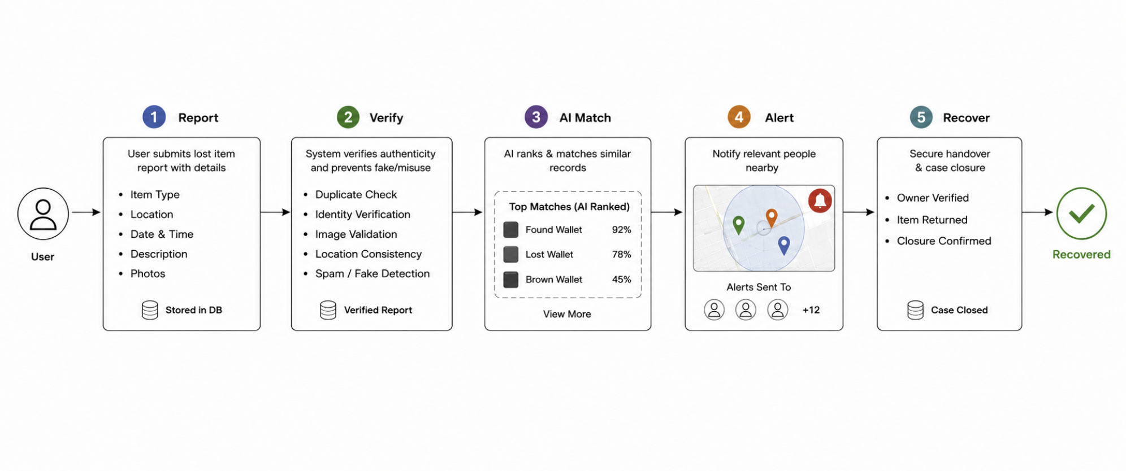
Missing Report Workflow

Slide 7
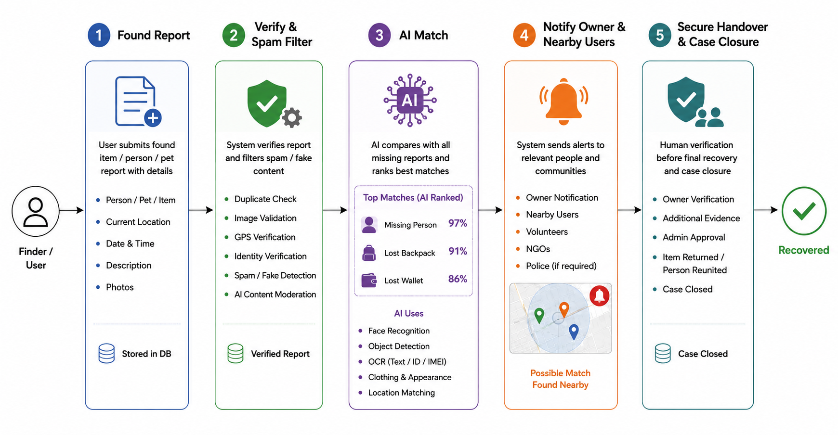
Found Report Workflow

Slide 8
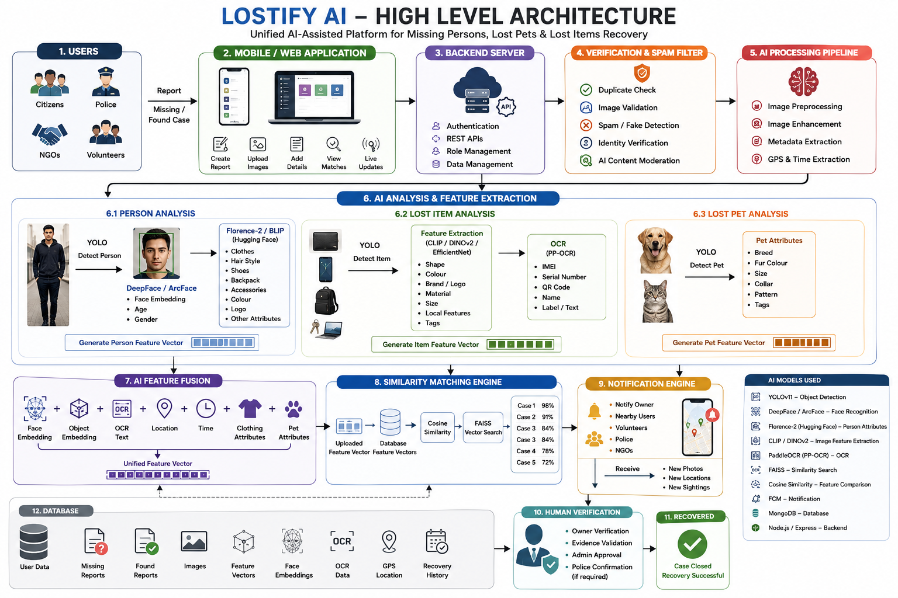
High-Level Architecture

Slide 9
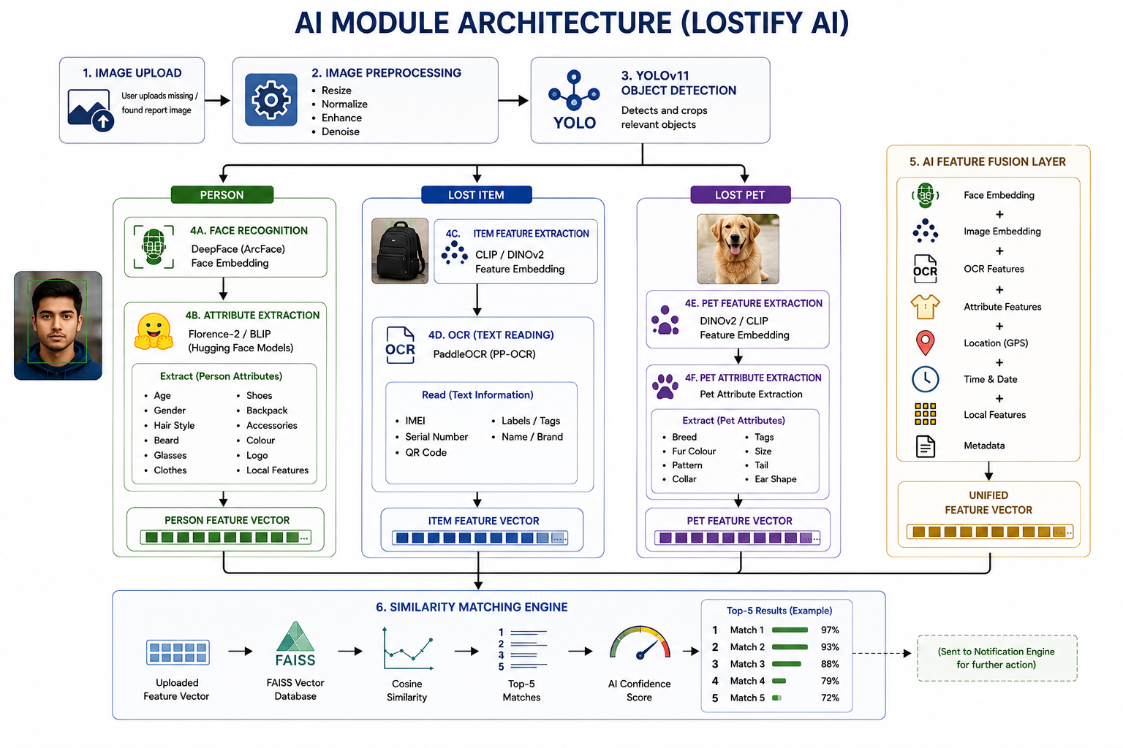
AI Module Architecture

Slide 10
Comparison with Existing Systems
Existing System | Main Limitation | Lostify AI Solution
NCMEC | Focused on missing children | Supports people, pets & items
Google Find Hub | Limited to enrolled Android devices | Supports public lost-item reporting
Petco Love Lost | Focused on pets | Extends matching to multiple categories
Social Media | Unstructured & weak verification | Structured reports & controlled access
Paw Boost | Pet-focused platform | Unified multi-category recovery
Apple Find My | Apple ecosystem dependent | Cross-platform recovery support

Slide 11
Major Modules/Features List
1. Citizen Mobile Application
  • User Registration & Login
  • Missing & Found Case Reporting
  • Image & Evidence Upload
  • Live Location Sharing
  • Nearby Alerts & Notifications
  • Sighting Submission
2. AI-Assisted Matching
  • YOLOv11 Object Detection
  • DeepFace Face Recognition
  • CLIP/DINOv2 Feature Extraction
  • PaddleOCR Text Extraction
  • FAISS Similarity Matching
  • AI Confidence Scoring
3. Report Verification
  • Duplicate Report Detection
  • Spam & Fake Detection
  • Image Validation
  • Identity Verification
  • Human Verification
4. Location Intelligence
  • GPS Tracking
  • Nearby Case Detection
  • Geo-Fencing
  • Location-Based Notifications

Slide 12
Major Modules/Features List
5. Community Collaboration
  • Submit Sightings
  • Upload Photos & Evidence
  • Community Feedback
  • Volunteer Participation
6. Partner & Admin Portal
  • Case Review & Verification
  • User & Role Management
  • AI Match Monitoring
  • Recovery Analytics
  • Dashboard & Reports
7. Security & Communication
  • Role-Based Access Control
  • Secure Data Storage
  • Push Notifications
  • Email & SMS Alerts
  • Audit Logs
8. Recovery Management
  • Owner Verification
  • Secure Handover
  • Case Closure
  • Recovery History
  • Recovery Reports

Slide 13
Stakeholders
Citizens / Families / Owners
  Create reports
  Provide accurate information
  Receive updates
  Confirm recovery
Volunteers / Community Members
  View approved nearby cases
  Submit sightings and tips

Slide 14
Stakeholders
  Review authorized cases
  Contribute recovery information
System Administrators
  Manage users and roles
  Moderate cases
  Manage broadcasts and audit records
Project Supervisor
  Reviews project scope, ethics, progress, and deliverables

Slide 15
Business Model
Potential Business Model:
  Freemium Access: Basic reporting and recovery services remain free.
  Partner Organizations: NGOs and shelters can use advanced management features.
  Premium Services: Optional enhanced features for organizations and businesses.
  Institutional Partnerships: Collaboration with authorized organizations and public safety bodies.
  Corporate Sponsorships: Support from companies interested in social-impact initiatives.
  Future Expansion: Analytics and advanced tools for authorized partner organizations.
Social Impact Focus:
The primary goal is to improve recovery outcomes and public safety, not to commercialize emergency assistance.

Slide 16
Tools and Technologies
Category | Tools / Technologies | Purpose
Mobile Application | Flutter, Dart | Cross-platform Android & iOS app
Web Portal | React.js, TypeScript | Admin dashboard & case management
Backend | Node.js, Express.js | REST APIs & business logic
Database | PostgreSQL, PostGIS | Users, reports & geospatial data
AI Services | Python, FastAPI, PyTorch | Run AI models & inference APIs
Computer Vision | OpenCV, YOLOv11, DeepFace (ArcFace), Florence-2, DINOv2/CLIP, PaddleOCR | Detection, recognition, feature extraction & OCR
Maps & Notifications | Google Maps Platform, Firebase Cloud Messaging | Maps & real-time notifications
Security | JWT, BCrypt, HTTPS, OWASP ASVS | Authentication & application security
LOSTIFY AI

Slide 17
Potential Impact on Society
Faster Recovery: Reduces the time required to circulate missing and lost cases.
Centralized Reporting: Provides one platform for multiple recovery categories.
Community Participation: Enables volunteers and citizens to contribute useful sightings.
Improved Accuracy: AI helps identify possible matches and reduce manual search effort.
Better Coordination: Connects citizens, volunteers, NGOs, and authorized organizations.
Enhanced Trust: Secure verification, evidence management, and audit logs reduce false claims.
Public Safety: Supports faster information sharing while maintaining human oversight.

Slide 18
System Limitations
The prototype will not directly connect to live police, hospital, shelter, or telecom databases without approval.
AI similarity and OCR results may be inaccurate and require human review.
Real-time tracking will not be provided without explicit user consent.
Emergency cases must still be reported through official emergency channels.
Sensitive and biometric data requires consent, restricted access, and secure storage.
Location alerts depend on device permissions, internet connectivity, and location accuracy.
The FYP prototype will primarily use test/dummy data.

Slide 19
References
[1] National Center for Missing & Exploited Children. “Missing Children Resources.” Internet: https://www.missingkids.org/ [Jul. 13, 2026].
[2] Google. “Find, Secure, or Erase a Lost Android Device.” Internet: https://support.google.com/android/answer/6160491 [Jul. 13, 2026].
[3] Petco Love. “Petco Love Lost: Report and Search Lost and Found Pets.” Internet: https://petcolove.org/lost/ [Jul. 13, 2026].
[4] Google. “Google Maps Platform Documentation.” Internet: https://developers.google.com/maps/apis-by-platform [Jul. 13, 2026].
[5] Google. “Firebase Documentation.” Internet: https://firebase.google.com/docs [Jul. 13, 2026].
[6] Flutter. “Flutter Documentation.” Internet: https://docs.flutter.dev/ [Jul. 13, 2026].

Slide 20
References
[6] Flutter. “Flutter Documentation.” Internet: https://docs.flutter.dev/ [Jul. 13, 2026].
[7] Node.js. “Node.js Documentation.” Internet: https://nodejs.org/en/docs/ [Jul. 13, 2026].
[8] PostgreSQL Global Development Group. “PostgreSQL Documentation.” Internet: https://www.postgresql.org/docs/ [Jul. 13, 2026].

Slide 21
Thank You

